Slide 1
Adversary Argument and Selection
张胜
sheng@nju.edu.cn
南京大学

Slide 2
Adversary Argument

Slide 3
Adversary Argument
Let b = b₁ b₂ b₃ b₄ b₅ be a bit string of length 5, i.e. ∈{0,1} b_{i} for 1≤ i ≤ 5. Consider the problem of determining whether b contains three consecutive ones, i.e. whether or not b contains the substring 111. We restrict our attention to those algorithms whose only allowable operation is to peek at a bit.

Slide 4
First Glance…
Obviously 5 peeks are sufficient.
A decision tree argument provides the fact that at least one peek is necessary.
useless
included

Slide 5
Adversary Strategy
Consider any algorithm for this problem and start it on an unspecified bit b string of length 5. The adversary strategy is to answer 0 to any bit peek, unless that answer would prove that b does not contain three consecutive ones.
0 | 0 | 1 | 1 | 1
1
2
3
0 | 0 | 0 | 1 | 0
b₁ | b₂ | b₃ | b₄ | b₅
0 | 0 | × | 1 | ×

Slide 6
Daemon Algorithm: Peek
Let x =11111 and y = 00000
Function flip(u,i)
which takes a bit string u and flips it’s ith bit (0 to 1, or 1 to 0), then returns the new bit string.
When the algorithm peeks at bit i, the Daemon performs the algorithm Peek(i).

Slide 7
Daemon Algorithm: Peek
Let x =11111 and y = 00000
Function flip(u,i)
which takes a bit string u and flips it’s ith bit (0 to 1, or 1 to 0), then returns the new bit string.
When the algorithm peeks at bit i, the Daemon performs the algorithm Peek(i).
Peek(i)
1. if flip(x, i) contains
the substring 111
2. x ← flip(x, i)
3. answer 0
4. else
5. y ← flip(y, i)
6. answer 1

Slide 8
Lower Bound by Adversary Strategy
If only 3 peeks have been performed, then y can contain at most 2 ones.
To prove this, assume that after peeking at 3 bits, y contains 3 ones. Then it must be the case that if any of those bits were flipped in x =11111, then x would not contain the substring 111. But there are not 3 such bits in x =11111.
If only 3 peeks are performed, y cannot contain the substring 111.
Algorithm with 3 peeks could not possibly be correct
If the verdict is yes, we can claim that b = y
Else if the verdict is no, we can claim that b = x

Slide 9
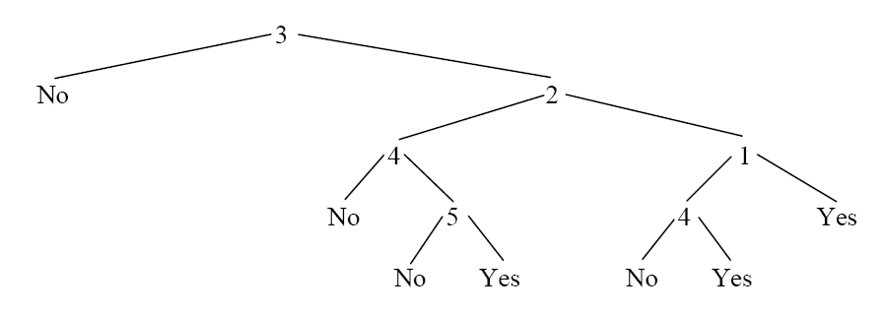
Possible Solution
The height of this decision tree is 4, by the above proof, this is the optimal algorithm.
0
1
0
1

Slide 10
Connectedness of a Graph
If an undirected n-vertex graph G = (V, E) is represented as an n*n adjacency matrix A.
How many entries do we have to look in the adjacency matrix to decide whether a graph is connectedness?
Notes:
Y contains all the edges that the algorithm knows are definitely in the input graph.
M contains all the edges that the algorithm thinks might be in the input graph.

Slide 11
The adversary strategy
The adversary maintains two graphs, Y and M (short for ‘yes’ and ‘maybe’, respectively). Initially, Y is empty and M is complete.
Adversary_Conn(e)
if M \{e} is connected
remove (i, j) from M
return 0
else
add e to Y
return 1
Notes:
Y contains all the edges that the algorithm knows are definitely in the input graph.
M contains all the edges that the algorithm thinks might be in the input graph.

Slide 12
The Adversary Strategy
Invariants
Y is a subgraph of M.
M is connected
If M has a cycle, none of its edges are in Y.
Y is acyclic.
If Y ≠ M, then Y is disconnected.
Adversary_Conn(e)
if M \{e} is connected
remove (i, j) from M
return 0
else
add e to Y
return 1
If an algorithm terminates before examining all edges, then there is at least one edge in M that is not in Y .

Slide 13
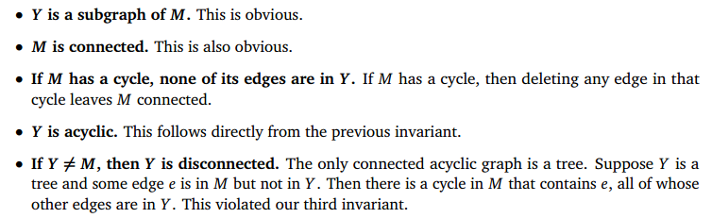
The Adversary Strategy
Adversary_Conn(e)
if M \{e} is connected
remove (i, j) from M
return 0
else
add e to Y
return 1

Slide 14
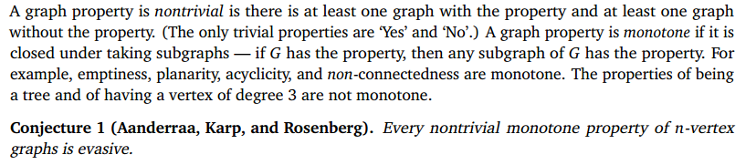
More Thought…
Is the input graph acyclic? Complete? A tree?
We call a graph property evasive if we have to look all C(n,2) edges to decide whether a graph has that property.

Slide 15
Selection

Slide 16
寻找“名人”
给定n个人。我们称一个人为“名人”，如果他被其他所有人认识，但是自己不认识任何人。为了找出名人，我们唯一可以进行的操作是：针对两个人A和B，询问“A是否认识B”。答案只可能是YES（A认识B）或者NO（A不认识B）。
1) 在一群共n个人中，可能有多少个名人？
2) 请设计一个Θ (n²)的算法找出名人。
3) 请设计一个O (n)的算法找出名人。
Notes:
Zero or one
Trivial
We use A->B to represent A knows B, and use A !->B to represent A does not know B
For two persons,
If A->B, then A is not the celebrity
If A!->B, then B is not the celebrity
Checking one pair can remove one possible person.

Slide 17
赛马问题
共有25匹马，每次可选5匹马进行比赛，并得到次序（无法计时）。问至少要比赛多少次才能确定跑得最快、次快和第三快的三匹马，并证明其最优性。
提示
类比于寻找最大值、第二大值
信息单元
快
慢
A1 | A2 | A3 | A4 | A5
B1 | B2 | B3 | B4 | B5
C1 | C2 | C3 | C4 | C5
D1 | D2 | D3 | D4 | D5
E1 | E2 | E3 | E4 | E5
慢
Notes:
敌手策略（信息单元）：
（1）最快的马
确定最快的马，需要有24个“输过”信息元。
一次比赛最多增加4个“输过”（类似于一次比较最多增加一个“输过”）。
因此，确定最快的马，需要至少赛6场。
（2）第二快的马
直接“输过”最快马的马，是第二快马的候选。最快的马至少参加了$\left\lceil \log_{5}{25}\right\rceil$次（即2次）比赛（类似于最大元素直接的比较次数为$\left\lceil \log_{2}{n}\right\rceil$）。因此，有两匹马为第二快马的候选。
（3）第三快的马
直接“输过”最快或第二快的马，共有3个候选。
第（2）和（3）综合，再进行一次比赛，就可以得到第二快与第三快的马。总共需要进行7次比赛。

Slide 18
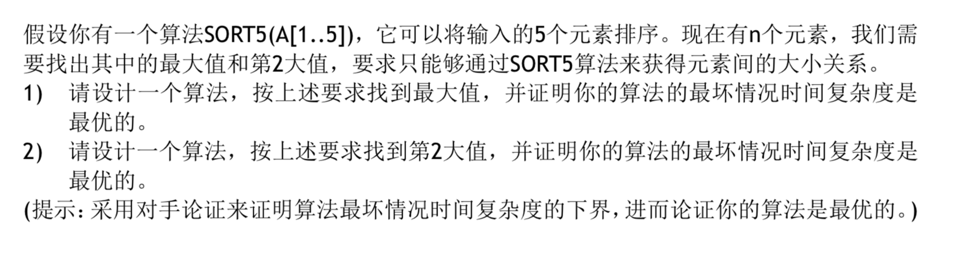
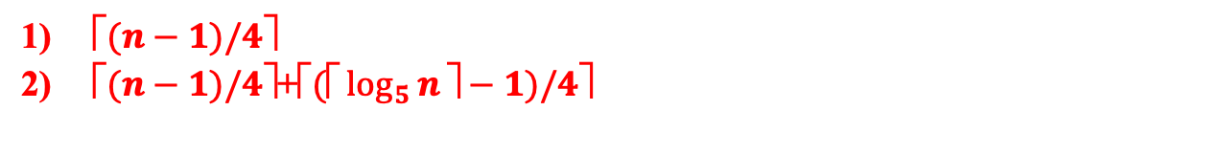
$\text{⬆}(n−1)/4\text{}$
$\text{⬆}(n−1)/4\text{}\text{+}\text{⬆}(\text{⬆}\log_{5}{n}\text{}−1)/4\text{}$

Slide 19
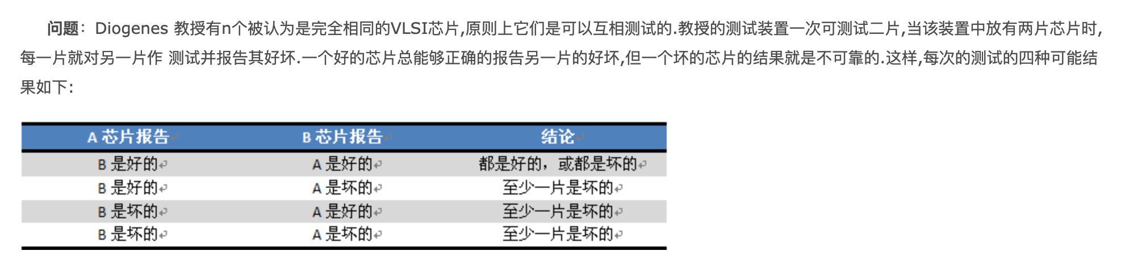
请用对手论证证明，如果坏芯片的数目不少于总数的一半，则任何算法都不能确保正确检测所有芯片的好坏。

Slide 20
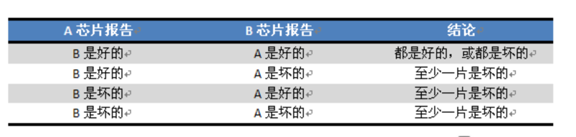
解答：对手可以控制坏芯片给出的结果。我们以4个芯片ABCD为例来说明：第1种情况是ABCD依次为好好坏坏，第2种情况是坏坏好坏。我们用G表示好，B表示坏。
比较的2个芯片 | 第1种情况下的报告 | 第2种情况下的报告
AB | GG | GG
AC | BB | BB
AD | BB | BB
BC | BB | BB
BD | BB | BB
CD | BB | BB
通过上表，我们发现，我们可以控制坏芯片的输出，来使得任何算法都无法分辨上面2种情况

Slide 21
请用对手论证证明，如果坏芯片的数目不少于总数的一半，则任何算法都不能确保正确检测所有芯片的好坏。
思考题：如何正确的判断每一块芯片的好坏？
Notes:
提示：分治

Slide 22
Weighted Median
For n distinct elements x₁, x₂,…,x_{n}
Positive weights w₁, w₂,…,w_{n}
Weighted (lower) median: x_{k} satisfying
and

Slide 23
Weighted Median
Argue that median of x₁, …,x_{n} is the weighted median of x_{i}, with weights w_{i} = 1/n
Compute the weighted median in O(nlgn) worst-case time
Compute the weighted median in Θ(n) worst-case time

Slide 24
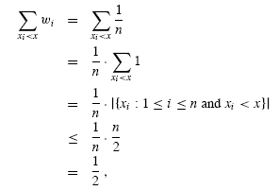
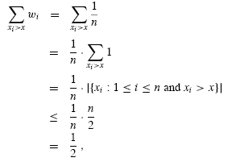
Q1. median = weighted median
Median x_{k} satisfying
|{x_{i}<x_{k}}| <= n/2
|{x_{i}>x_{k}}| <= n/2
For equal weights 1/n

Slide 25
Q2. Weighted Median by Sorting
Sort n elements in increasing order by value of x_{i}, in Θ(nlgn) time
Accumulate the weights of elements from x₁ to x_{k}, until the aggregate weights exceeds ½
The last element x_{k} is the weighted median
Verify by definition

Slide 26
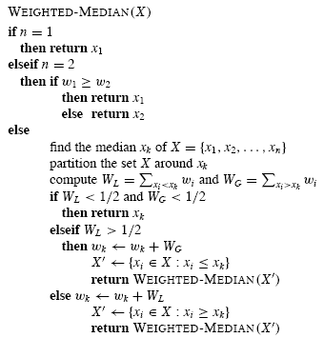
Q3. Linear Worst-case Time
n < 2, trivial case
Find Actual median x_{k} and PARTITION
Compute the aggregate weights of “smaller” and “larger” parts
If aggregate weights < ½: return x_{k}
Else reduce the problem to the larger part

Slide 27
Analysis
T(n) = T(n/2+1) + Θ(n)
Why the problem size is reduced by half?
T(n) = Θ(n)
by master’s theorem
E = lg(b) / lg(c) = 0, f(n) = Θ(n)
case 3: f(n)∈Ω(n^{E+ε}), (ε>0), and f(n)∈O(n^{E+δ}), (δ≥ε), then:
T(n)∈Θ(f(n))

Slide 28
Randomized Selection: the Algorithm
Input: S, a set of n keys; and k, an integer such that 1≤k≤n.
Output: The kth smallest key in S.
Note: Median selection is only a special case of the algorithm, with k=⎡n/2⎤.
Procedure
Element select (SetOfElements S, int k)
if (|S|≤5) return direct solution; else
Constructing the subsets S₁ and S_{2;}
Processing one of S₁, S₂ recursively.
Select x from S randomly;
S₁: smaller than x;
S₂: larger than x.

Slide 29
最小未出现自然数
n个大小各不相同的自然数，找出不在这个自然数序列中出现的最小自然数。
“1、2、4、5”中最小未出现是3。
“6、1、4、5、7”中最小未出现是2。
分别就下面两种情况设计算法
若n个元素是已排序的
若n个元素是未排序的
Notes:
（方法1）首先找到median元素m，比较m与n/2的大小，继续进行分治求解。O(n)+O(n/2)+ …. =O(n)
（方法2）新开一个长为n的flag数组，全部置0；
扫描这n个自然数，将扫描到的自然数对应的flag置1；（例如，扫描到15，则将flag[15]置为1）
在flag数组上，找到第一个为0的位置，即可

Slide 30
k Largest Numbers
Given a set of n numbers, we wish to find the k largest numbers in sorted order, using a comparison-based algorithm.
Sorting and getting the last k numbers.
O (n log n)
Using a heap and exacting the first k numbers.
O (n + k log n)
Getting the kth largest number, then partitioning and sorting.
O (n + k log k)
Notes:
前k个最大数字
1。排序
2。用堆
3。确定第k个，再划分

Slide 31
Finding the “Heavy” Element
Find the element i with freq(i) > n/2 in an array of n elements. Here, freq(i) is defined as the number of occurrence of i in the array.
Notes:
方法1：找中位数，如果有heavy element，那必然就是中位数。
方法2：分治法
方法3：
1．如果序列的元素个数是奇数个，那么最后一个作为候选者暂存，对于余下的偶数个数的序列：
满足有一个元素出现的次数>=n/2
将序列中的元素先两两比较，如果这两个数相等，那么就把这个数记下来，存放到另外一个数组。
由于某个元素出现次数大于n/2，所以至少有一对数字是相同的
在最坏情况下比较之后会有n/2对这样的数（如：4，4，4，4，3，3）->（4，4，3）
可以证明这个新序列中的数字也满足原序列一样的性质，即
如果该序列是偶数个数，那么需要找的那个数字出现次数在这个新生成的序列中的出现次数>=n/2；如：3，3，4，4，4，4，3，3 | 4）->（3，4，4，3）|4，其中4为暂存元素
如果该序列是奇数个数，那么需要找的那个数字出现次数在这个新生成的序列中的出现次数>n/2；
2．对于新的数字序列（<=n/2个）递归的进行1中步骤（如果是奇数个数也同样将最后一个暂存）
3．最终新序列只有一个数字或者没有数字
如果只有一个那么该数字就是要求的数字；
如果没有，那么递归地向上层返回，每返回一层就检查一下是否有暂存的数字，如果有那么该暂存数字就是要求的
时间复杂度的分析：
1中第一次比较扫描了一遍，并且比较了n/2次；
2中递归做，同样的扫描一遍，worst-case，扫描n/2个元素，做n/4次比较；依次类推，递归深度log2n；
总的时间复杂度：
比较次数：n/2+n/4+n/8+… <=n
元素访问：n+n/2+n/4…<=2n
所以是线性时间复杂度的算法。
算法中证明新的序列满足和原来序列有相同的性质是关键。（利用书本5.3.2的tournament method）

Slide 32
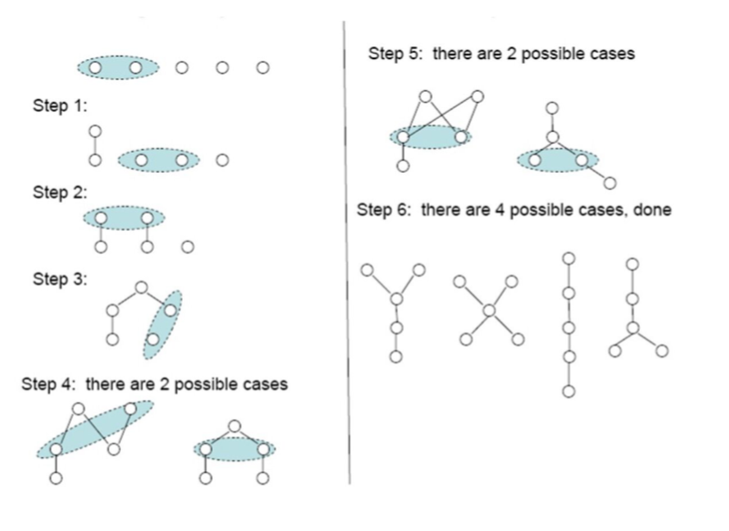
Find the median of 5 elements using 6 comparisons (Method 2)

Slide 33
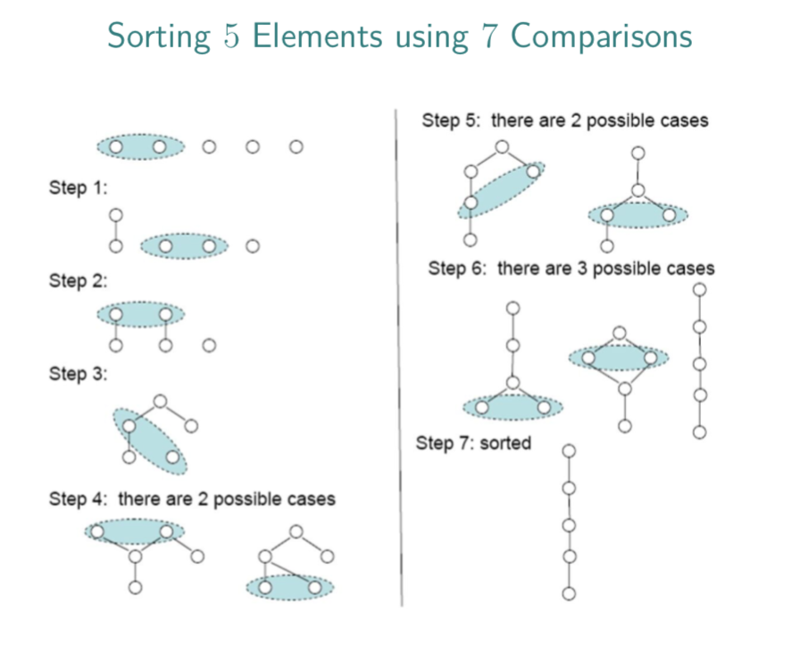
Sorting 5 elements using 7 comparisons

